Slide 1
District Lions Club
http://www.5selions.org/

Slide 2
Organizational Structure
There are 750 districts worldwide with 35 or more clubs and at least 1,250 members in each district.
Each district has a district governor
Multiple districts are formed by two or more districts within a territory.
Multiple District 5: includes South Dakota, North Dakota and Saskatchewan, Canada
Our District: 5SE
District conventions are held to:
Develop fellowship among the Lions of the district
Conduct general district business
Elect the district governor and other district-elected officers
Conduct seminars
Notes:
Trainer Tip: Consider adding additional information about your district and multiple district, such as the district governor’s name and the boundaries of your district and multiple district.

Slide 3
Proud Lion Award – new members only
District 5-SE - Proud Lion Award - Requirements
This award shall be presented to new Lion members who, during their first full year of membership, achieve the following requirements:
1. Attend his/her Lions Club’s new member orientation program.
2. Attend at least one meeting of the Club’s Board of Directors.
3. Participate in at least one Lions Club activity or project.
4. Accept his/her Lions Club committee assignments.
5. Attend a Zone meeting or other District activity.
6. Attend a meeting of another Lions Club.
7. Bring a guest to his/her Lions Club meeting.
The application shall be properly documented and signed by the applicant and club secretary.
The award shall consist of a certificate and lapel pin, properly presented by the District Governor, Vice District Governor, Region Chairman, Zone Chairman, or Past International Director.

Slide 4
Proud Lion Award – form
Notes:
Trainer Tip: Add any additional meeting information you feel is important.

Slide 5
Lions Clubs International
http://www.lionsclubs.org/EN/index.php

Slide 6
History
1917: Melvin Jones founded LCI.
1920: LCI becomes international with Canadian club.
1925: Helen Keller challenged Lions to become “knights of the blind.”
1945: LCI helped draft the United Nations Charter.
1957: The Leo Club Program is created.
1968: The Lions Clubs International Foundation is established.
1990: SightFirst is launched.
Today: Our international network has grown to include more than 200 countries and geographic areas.
1987: LCI became the first service club organization to admit women as members.

Slide 7
Name and Logo
The official name of the association is “The International Association of Lions Clubs” or simply “Lions Clubs International.”
The name Lions was chosen on a secret ballot over several others because the lion stood for strength, courage, fidelity and vital action.
The Lions logo consists of a gold “L” on a blue field surrounded by a gold circle. On either side of the circle is the profile of a Lion’s head, one looking back upon a proud past and the other looking optimistically toward the future.

Slide 8
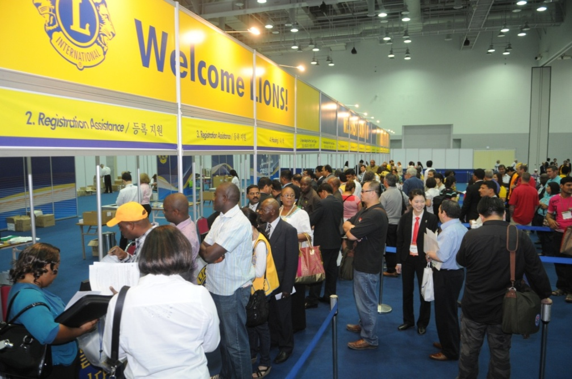
International Convention
Convention brings together thousands of Lions from around the world for a week of business, education, celebration and fellowship.
2014: Toronto, ON, Canada.
2015: Honolulu, Hawaii, USA.
2016: Fukuoka, Japan.
2017: Chicago, Illinois, USA.
LCI returns to Chicago
to celebrating its 100th
Anniversary!

Slide 9
Lions Clubs International Foundation (LCIF)
LCIF grants an average of US$30 million annually. It provides clubs with the means to build schools, health clinics, vocational rehabilitation, training centers and other projects that address community needs.
LCIF SightFirst reduces and eliminates blindness worldwide. The program targets the leading causes of preventable blindness which affects millions of people each year.
Since it’s launch in 1990, Lions have raised over US$415 million for SightFirst, making LCIF the world's largest blindness prevention organization.

Slide 10
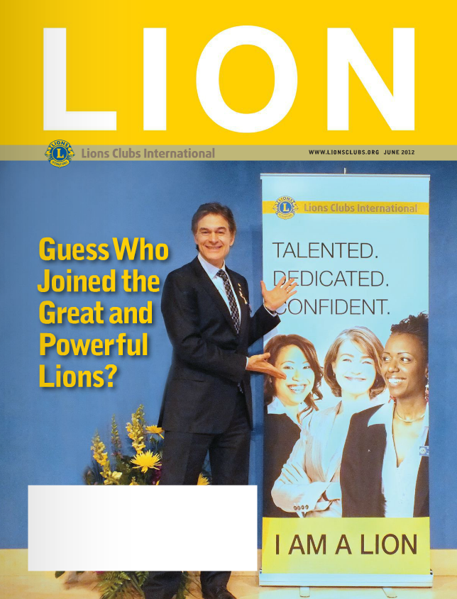
Communications
LION Magazine
E-mail Messages
Web site: http://www.lionsclubs.org/EN/index.php
Social Networking
Facebook
www.facebook.com/lionsclubs
Twitter
https://twitter.com/lionsclubsorg

